Slide 1

CMR Technical Campus Department of CSE
Fundamental of Internet of things
Sensor-Cloud Architecture for FIOT
Presented By:​
Shiva Kumar
227R1A05J3
CSE-C
​

Slide 2
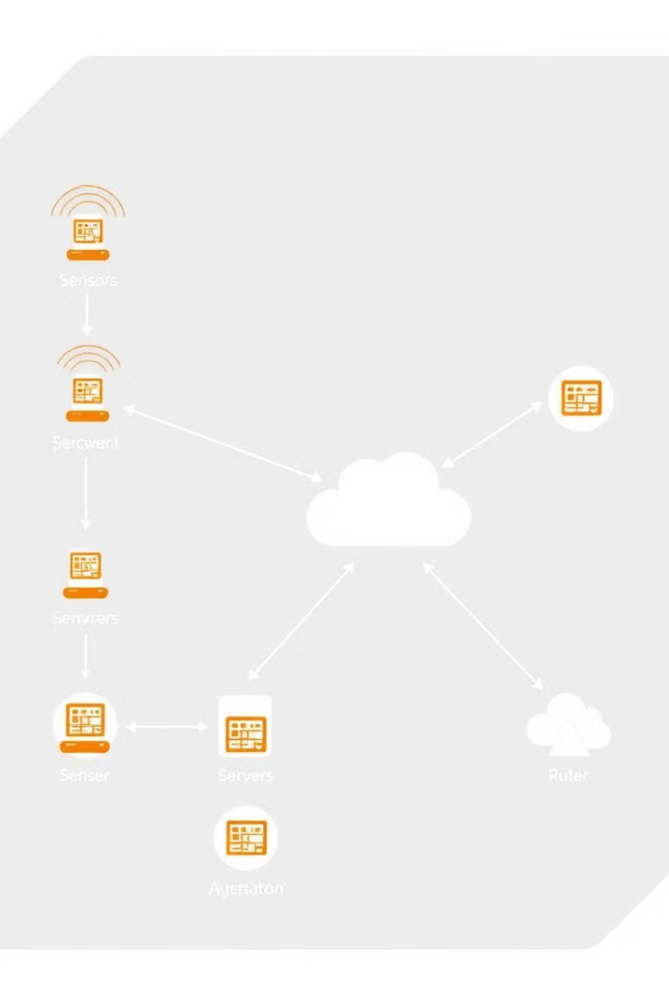
Architecture Overview: Layered Approach
Sensor Layer
Collects and preprocesses data from the environment.
Network Layer
Securely transmits data to the cloud infrastructure.
Cloud Layer
Performs storage, processing, and analytics on sensor data.
Application Layer
Enables FIOT services and user interfaces.

Slide 3

Security and Privacy in FIOT
End-to-End Data Encryption
Protects sensitive financial data during transmission and storage.
Role-Based Access Control
Ensures only authorized users can access data and functions.
Anomaly Detection
Machine learning recognizes fraudulent and suspicious activity patterns.
Compliance Standards
Meets GDPR, CCPA, and other privacy regulations for data handling.

Slide 4

Sensor Layer (Perception Layer)
Components
Functions
Sensors, actuators, embedded systems capturing environment data.
Data collection and local preprocessing like filtering and storage.
Communication
Uses wireless protocols such as ZigBee, Bluetooth, LoRa, Wi-Fi.

Slide 5

Network Layer (Communication Layer)
Components
Functions
Gateways, routers, mobile networks, and Internet links.
Routing data securely from sensors to cloud infrastructure.
Challenges
Addressing latency, bandwidth limits, and ensuring data security.

Slide 6
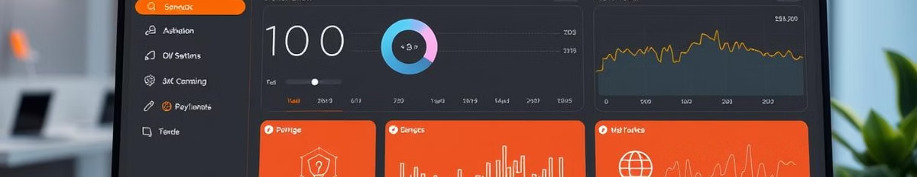
Middleware Layer
Components
Functions
Additional Roles
Sensor management software, APIs, and middleware platforms.
Abstracts hardware, manages devices, and formats data.
Handles context awareness, quality of service, and interoperability.

Slide 7
Cloud Layer (Processing & Storage)
Components
Functions
Leading Platforms
Cloud servers, databases, and analytics engines.
Massive storage, real-time processing, and predictive analytics.
AWS IoT, Azure IoT Hub, Google Cloud IoT Core services.

Slide 8
Sensor-Cloud Integration: WSN + Cloud
Wireless Sensor Network (WSN)
Cloud Computing
Handles local data acquisition and initial processing.
Manages global storage, analytics, and user interfaces.

Slide 9
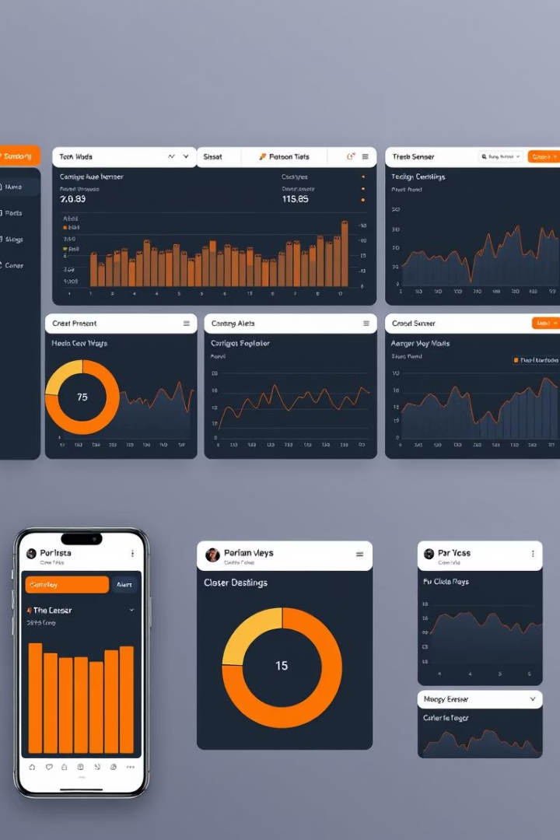



Application Layer
User Interaction
Visualization and control of sensor data through apps.
Management
Controls sensor systems such as automation triggers.
Use Cases
Applications include smart finance, health, and industrial monitoring.

Slide 10

Future of Sensor-Cloud in FIOT
Innovation Driver
Enables real-time analytics and financial process automation.
Key Benefits
Scalability, improved security, and seamless data integration.
Emerging Trends
AI-powered FIOT, decentralized architectures, and enhanced edge security.

Slide 11


